Slide 1
Overview of educational chatbots and the practical need for a high school integrated science Q&A chatbot in a real school environment
Gyeongmo Min, Junehee Yoo
Seoul National University
Notes:
Hello everyone. Today, I will talk about educational chatbots and why we need a science Q&A chatbot in real high school classrooms. This talk is based on my research and real experience in schools. I am a physics and integrated science teacher at a Beombak high school, and a lecturer at Seoul National University.
This presentation explains brief chatbot history and why we needs a special science Q&A chatbot in middle schools and high schools.

Slide 2
What We Will Cover Today
Very brief history of chatbots and large language models (LLMs)
Educational chatbots powered by LLMs
7 design principles for good educational chatbots (Kuhail et al., 2023)
Problems with Current Educational Chatbots
Special situation of high school “Integrated Science” in Korea
Role of students' questions in science education
Practical need for a science Q&A chatbots in Korea
Tomorrow, I’ll focus on live demo of implementation of a customized chatbot we developed. If you want to setup this system, please bring your own laptop.

Slide 3
What is a Chatbot?
A chatbot is a computer program that talks with people using normal, everyday language.
It can be a helpful friend who answers questions 24 hours a day.
Nowadays, many employees who are working at support center are substituted with chatbot services…
In schools, chatbots act as a second teacher that never gets tired.
They give instant answers, remember conversations, and explain step by step.
In Korea, we want chatbots that work well with Korean language and real school needs.

Slide 4
Early Chatbots – Rule-Based Era (until 1995)
Early chatbots used simple rules: “If question is X, then answer Y.”
People wrote thousands of rules and expected Q&A pairs by hand.
Famous examples:
ELIZA (1966, MIT) acted like a psychologist.
PARRY (1972) acted like a patient.
In Korea: MAX (1993) was very popular on old PC networks for small-talk.
Problem
Ancient chatbots could not answer new questions if developers did not input exact if-then statement.
Notes:
Let’s get it started with short history of chatbots.
The ancient chatbots are developed in the field of psychiatry. ELIZA and PARRY are famous examples worldwide.

Slide 5
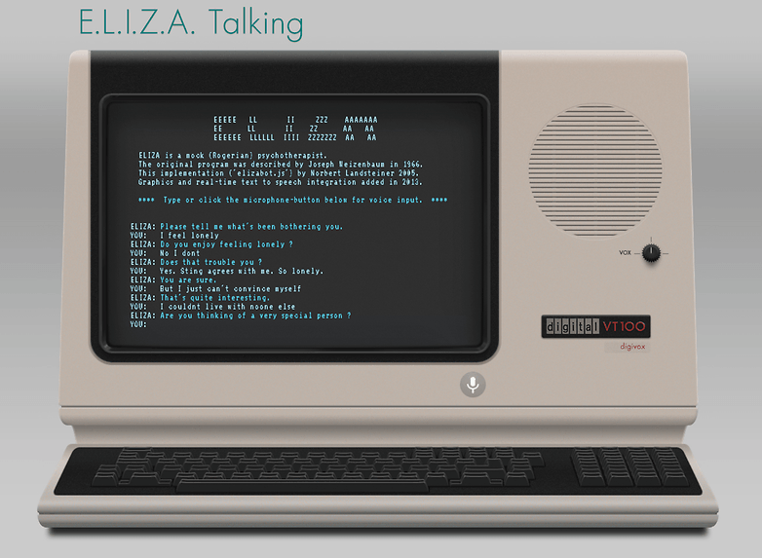

Slide 6
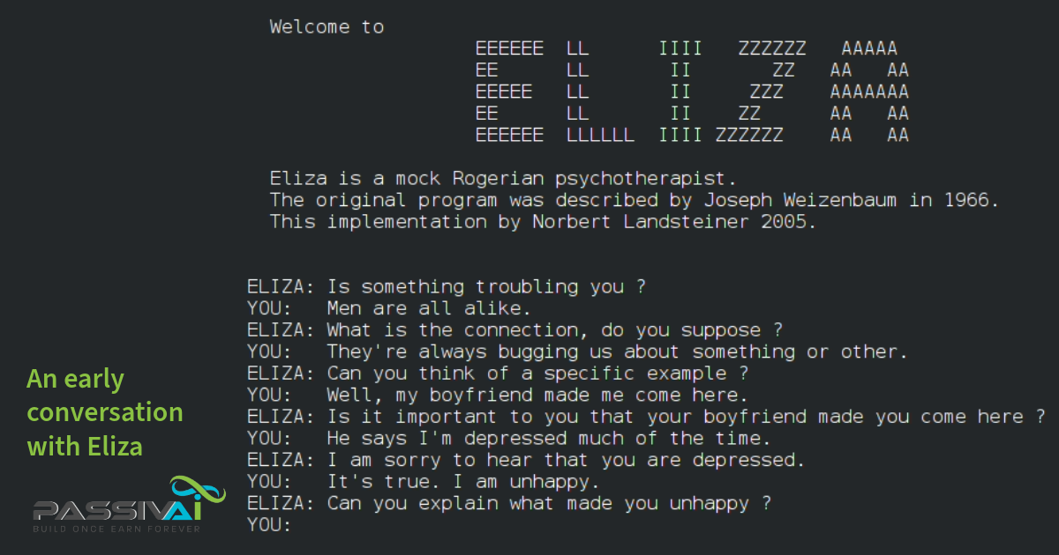
웹 버전

Slide 7
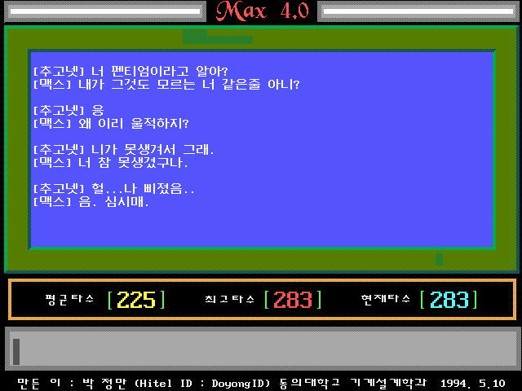

Slide 8
Pattern Matching and Data-Based Chatbots (1995–2015)
Next, pattern matching tried to understand sentence structure.
ALICE (1995) used this method.
From 2006: Added Natural Language Processing (NLP) and machine learning (DNN, RNN).
Examples: IBM Watson (2006), Apple Siri (2011).
Korean NLP tools: Hannanum, Kkma, Mecab, Okt – these helped Korean chatbots understand Korean language better.

Slide 9
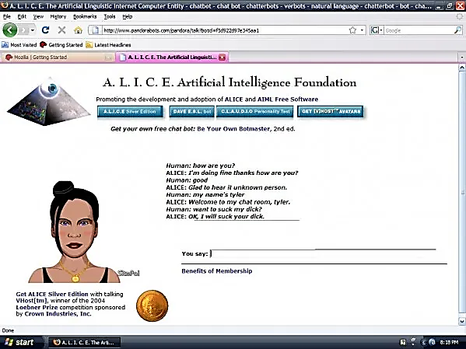

Slide 10
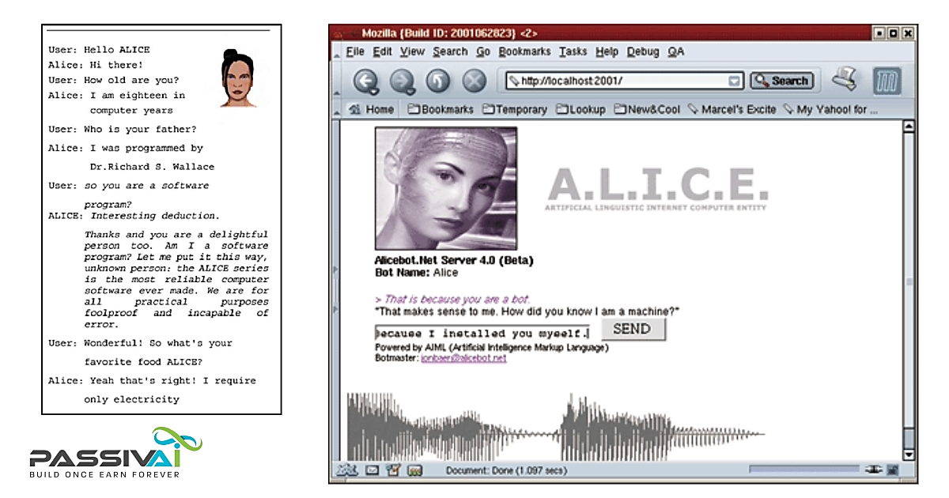

Slide 11
Limitations Before LLMs
Rule-based and early data-based chatbots were limited.
it is impossible to input all the expected Q&A pairs and conversation pairs with context.
Incapable of multi-turn conversation
They could not remember long conversations well (even RNN and LSTM helped only a little).

Slide 12
The Big Revolution – Large Language Models (2017–2022)
In 2017, Google invented Attention mechanism and Transformer model.
This let models understand whole sentences and real meaning.
Important models
BERT (2018, Google)
GPT series (2018~, OpenAI).
Korean example: Early “Iru-da” (2020) used BERT but had problems
This was a famous failure case in inappropriate bias of its outputs because of its dataset.
In 2022, OpenAI ChatGPT made LLMs popular worldwide.

Slide 13
Current LLMs
LLM which are widely used today
Almost all of the commercial LLMs developed in the United States.
Gemini (Google), Claude (Anthropic), ChatGPT (OpenAI), …
Open source LLMs developed in China: DeepSeek, Qwen, …
In Korea, both the government and companies like LG AI Research are actively working to develop their own AI models (i.e. sovereign AI models).
New trends
Multi-modal (text + images + audio + …)
RAG (referencing from real documents to generate outputs)
Small Language Models (for cost effective for edge devices / for privacy).
Agentic AI (AI plans and executes autonomously.)
Still challenges: Hallucination (wrong facts) and high cost.

Slide 14
Educational chatbots powered by LLMs
Large Language Models (LLMs) have rapidly advanced in the natural language processing field, enabling the application of generative AI-powered chatbots to educational settings.
LLMs can assist student-centered, personalized education. This is especially helpful for teachers and students.
However, it is necessary to consider the potential impact of inappropriate responses from chatbots on students(Jauhiainen et el. 2023).

Slide 15
Design Principles for Educational Chatbots
Kuhail et al.(2023) suggested 7 design principles (These are made before LLM era, but matter as ever):
Personalized learning – materials for each student’s level.
Experiential learning – help students think about their own experiences.
Social Dialog – friendly chat to build trust.
Collaborative learning – help group discussions.
Affective learning – for example, kind feedback (e.g. “Great job!” or “Don’t worry”).
Learning by teaching – ask questions and give examples.
Scaffolding – step-by-step help. These principles are especially useful in Korean schools.

Slide 16
Applications of Educational Chatbots
Akpan et al. (2024) revealed that the most frequently used LLM (Large Language Model) was OpenAI's ChatGPT, and the main research areas involved supporting teachers' work or aiding college students' learning.
Many developed educational chatbots often focus on specific subject areas and lessons for particular classes. (Min & Yoo, 2022).
Many educational chatbots fail to adequately consider the contextual factors within education and lack the ability to adequately reflect the specific characteristics of each school and the daily use of students especially for middle and high school.

Slide 17
Problems with Current Educational Chatbots
High cost of paid APIs
It can create digital divide in public schools. (API price is cheaper, but input and ouput tokens are much bigger)
The core of the AI chatbot is LLM. But LLM did not developed with real student questions from Korean schools and did not elaborately consider Korean cultural contexts.
As long as we don’t stop using the API for LLMs, we can't fundamentally solve security concerns.
Because LLMs are mainly made by companies in United States and China.

Slide 18
High School Integrated Science in Korea
Integrated Science is required for all 10th-grade students(MOE 2022).
Goal (2015 and 2022 curriculum, Ministry of Education in Korea): Understand natural phenomena and become scientifically literate citizens (MOE 2015; MOE 2022).
It combines physics, chemistry, biology, and earth science.
It connects middle school science to advanced subjects.

Slide 19
Difficulties in teaching Integrated Science in high school
In schools, a multi-teacher system is predominantly used, and issues such as curriculum planning and teacher assignments have been debated for many years.(곽영순, 신영준, 2021)
The challenges in the classroom still involve the complexity of integrating science into the curriculum and content, which is burdensome for both teachers and students. (윤지현, 강성주, 2016)
A survey revealed that teachers needed additional preparation for teaching science-related topics in other subjects.(신영준, 곽영순, 2016]

Slide 20
Importance of Cultural Context and Big Challenges in Korean Integrated Science
For more than 30 years, many Korean studies confirm these challenges(이학동, 1986; 김용성, 1994, 2000; 윤지현, 2016).
Too many topics.
Students have weak basics from middle school.
Teachers should teach outside their major.
Hard to explain everything to every student
But students need one connected understanding (안유민, 2020; 곽영순, 2021).
2022 curriculum still needs extra content from upper grades (이봉우, 2024).
This makes difficult for both students and teachers.

Slide 21
Role of Questions in Science Education
Questions show what students understand and do not understand (Chin, 2002; 2008).
Questions connect old knowledge with new ideas (김성근, 1999).
But teachers cannot answer every question individually in the class.
Delayed answers and follow-up questions help learning more(최경희, 2004).
Specifically, 9th-grade and high school students ask significantly more science-related questions compared to elementary and junior high school students.(Eshach et al., 2014).
Chatbots can be a solution. LLM can understand context, give step-by-step answers, and ask good follow-up questions.

Slide 22
The Practical Need for a Science Q&A Chatbot in Korea
We need a chatbot made for real Korean high schools.
To develop it, it’s good to use real student questions collected from that school.
It’ll be also good to use open-source LLM and RAG for accuracy and low cost.
LLM can support multi-turn talks (follow-up questions).
For security and usuability, running on school server is alternative way than using commercial services.
Korea has unique education challenges (big classes, one required science subject for all).

Slide 23
How a School Customized Science Q&A Chatbot Helps
Our solution uses open-source LLM + real local data. It respects culture and avoids cost problems.
It gives clear, step-by-step answers in natural Korean.
In the process, Kuhail et al. (2023) design principles would be followed.
There’s a way to consider cultural context when using chatbotsReduces teacher burden.
It can be a alternative way to solve digital divide problem.
For better Korean understanding, Korean NLP tools will help to solve this problem.
Perhaps similar ideas can help other countries’ public schools.

Slide 24
Benefits for Korean Science Education
Chatbot helps active learning and scaffolding.
Students can ask anytime without feeling shy.
Teachers can check logs and improve the system.
Matches real Korean school data and curriculum.
Research shows LLM chatbots work well for science questions (신원섭, 2020; Kasneci, 2023).

Slide 25
Conclusion
We have explored the history of chatbots and identified the practical need for an Integrated Science Q&A chatbot.
Though internal intelligence of commercial LLMs are powerful, customizing them with regional and specialized data is far more effective. This approach will be just as successful in Bulgaria as it has been in Korea.
The customized science chatbot serves as a second teacher that students can turn to with questions at any time.
These chatbots are effective learning tools for connecting fragmented scientific knowledge into a unified understanding.
Notes:
First, we looked at how chatbots evolved and why we specifically need them for Integrated Science today.
Many people rely on general AI, but using local, school-specific data makes a huge difference. I believe this model will work perfectly here in Bulgaria too.
Our chatbot acts as a 'second teacher,' always ready to help students whenever they have a question.
Finally, it helps students connect different scientific concepts together, making learning much easier.

Slide 26
References
Akpan, Ikpe Justice, Yawo M. Kobara, Josiah Owolabi, Asuama A. Akpan, and Onyebuchi Felix Offodile (2024). “Conversational and generative artificial intelligence and human–chatbot interaction in education and research”. International Transactions in Operational Research. DOI: 10.1111/itor.13522.
Chin, Christine and David E Brown (2002). “Student-generated questions: A meaningful aspect of learning in science”. International Journal of Science Education 24.5, pp. 521–549.
Chin, Christine and Jonathan Osborne (2008). “Students’ questions: a potential resource for teaching and learning science” . Studies in science education 44.1, pp. 1–39.
Eshach, Haim, Yair Dor-Ziderman, and Yana Yefroimsky (2014). “Question asking in the science classroom: Teacher attitudes and practices”. Journal of Science Education and Technology 23, pp. 67–81.
Jauhiainen, Jussi S. and Agustín Garagorry Guerra (2023). “Generative AI and ChatGPT in School Children’ s Education: Evidence from a School Lesson”. Sustainability 15.18. ISSN: 2071-1050. DOI: 10.3390/su151814025.
Kasneci, Enkelejda et al. (2023). “ChatGPT for good? On opportunities and challenges of large
Kuhail, Mohammad Amin, Nazik Alturki, Salwa Alramlawi, and Kholood Alhejori (2023). “Interacting with educational chatbots: A systematic review”. Education and Information Technologies 28.1, pp. 973–1018.
language models for education”. Learning and individual differences 103, p. 102274.
Smutny, Pavel and Petra Schreiberova (2020). “Chatbots for learning: A review of educational chatbots for the Facebook Messenger”. Computers & Education 151, p. 103862.
곽영순 · 신영준 (2021). 〈2022 개정 교육과정에 대비한 과학과 통합과학 및 과학탐구실험 교육과정 개선 방안 탐색〉. 『과학교육연구지』 45.2, pp. 143–155.
곽영순 · 신영준 (2021). 〈2022 개정 교육과정에 대비한 과학과 통합과학 및 과학탐구실험 교육과정 개선 방안 탐색〉. 『과학교육연구지』 45.2, pp. 143–155.
교육부 (2015). 『교육부 고시 제2015-74호 과학과 교육과정』.
교육부 (2022). 『교육부 고시 제2022-33호 [별책 9] 과학과 교육과정』.

Slide 27
References
김성근 · 여상인 · 우규환 (1999). 〈과학 수업에서의 학생 질문에 대한 연구 (Ⅱ)-학생 질문의 유형별 분석〉. 『한국과학교육학회지』 19.4, pp. 560–569.
김영성 · 이문남 (1994). 〈고등학교 과학 교사들의 공통과학 및 Science-Technology-Society에 대한 인식도 조사-광주 직할시 및 전라남도 고등학교 과학 교사들을 대상으로〉.『한국과학교육학회지』 14.3, pp. 330–343.
김영성 (2000). 〈고등학교’공통 과학’의 지도 실태〉. 『한국과학교육학회지』 20.2, pp. 200–213.
민경모 · 유준희 (2022). 〈Doc2Vec 을 이용한 중학교 과학 질문-답변 챗봇 개발 및 학생 질의 분석〉. 『The SNU Journal of Education Research』 31.3, pp. 115–145.
민경모 · 유준희 (2024). 〈인공지능 문장 분류 모델 Sentence-BERT 기반 학교 맞춤형 고등학교 통합과학 질문-답변 챗봇-개발 및 1년간 사용 분석-〉. 『한국과학교육학회지』 44.3, pp. 231–248. ISSN: 1226-5187.
민경모 (2005) 오픈소스 LLM과 RAG를 활용한 고등학교 통합과학 질문-답변 챗봇의 개발 및 평가 : Development and Evaluation of a Q&A Chatbot for High School Integrated Science using Open-Source LLM and RAG
신영준 · 곽영순 (2019). 〈2015 개정 교육과정의 통합과학 과목 편성･ 운영 실태 분석〉. 『과학교육연구지』 43.1, pp. 64–78.
신원섭 · 신동훈 (2020). 〈초등과학교육에서 인공지능의 적용방안 연구〉. 『초등과학교육』 39.1, pp. 117–132.
안유민 · 변태진 (2020). 〈통합과학은 통합적으로 운영될 수 있을까?: 적절한 통합과학 운영방식과 교과 역량 함양에 대한 과학 교사의 인식을 중심으로〉. 『현장과학교육』 14.3, pp. 365–378.
윤지현 · 강성주 (2016). 〈2015 개정 교육과정에서 통합과학과 과학탐구실험 교과에 관해 고등학교 과학 교사들이 기대하는 부분과 우려하는 부분에 대한 분석〉. 『학습자중심교과교육연구』 16.5, pp. 515–546.
이봉우 · 박재용 · 손정우 · 이기영 · 최원호 · 심규철 (2024). 〈과학 교과서 개발 과정에서 교육과정 적용에의 고민과 어려움-2022 개정 과학과 교육과정의 ‘통합과학’ 을 중심으로〉. 『Journal of the Korean Association for Science Education』 44.2, pp. 219–229.
이학동 (1986). 〈통합과학교육의 실태조사〉. 『한국과학교육학회지』 6.2, pp. 43–52.
최경희 · 박종윤 · 최병순 · 남정희 · 최경순 · 이기순 (2004). 〈중학교 과학 수업에서 교사와 학생의 언어적 상호작용 분석〉. 『한국과학교육학회지』 24.6, pp. 1039–1048.

Slide 28
High School Science Q&A Chatbot: A Hybrid IRQA–RAG Approach with an Open-Source LLMs (part 1: theoretical approach)
Gyeongmo Min, Junehee Yoo
Department of Physics Education, Seoul National University
Notes:
Hello, everyone. Thank you for inviting me today. I am very honored to speak at Plovdiv University.
I want to introduce myself first. I am a high school teacher in Korea — teaching 12th-grade students. As you know, teaching 12th graders is a very busy job. And I am an instructor at Seoul National University.
I got a dissertation last year, and doing research is my hobby. My high school classroom is my research laboratory. Today, I will share the results of my 5-year hobby with you.

Slide 29

Chatbot demonstration
You can access our science Q&A chatbot which is translated into Bulgarian.
https://acer2.snu.ac.kr:8503 (I am running a temporary web server for this chatbot.)
This template I made is for general purpose. As you can change dataset, you can make any chatbot you want for free.
Notes:
(Please look at the screenshot)
This is what my students see on their phones.
A student asks: 'Why is photosynthesis considered anabolism?'
The AI explains it step-by-step.
Below, you see buttons suggesting other related questions.

Slide 30
Introduction
A science teacher’s worries about AI chatbots
Cost: Public schools do not have enough money to pay for commercial AI services.
Privacy: We must protect student data. It’s necessary that students’ information do not flow to the public.
The Danger of AI Agents: If AI chatbots just give the final answer, students stop thinking for themselves.
AI agent solves complex problems automatically.
The AI does ALL the thinking.
Students just wait for the answer.
Reasoning process is invisible.
Student thinking is replaced, not supported.
We need an AI that acts as a 'Guide', not a 'Problem Solver'.
Notes:
As a teacher, I see many students using AI chatbots like ChatGPT.
But using commercial AI chatbots in public schools is difficult:
These three worries shaped every decision in our research.
Recently, smart 'AI Agents' are very popular. They can solve complex problems automatically.
But for simple high school science questions, this is dangerous.
The AI does the thinking, not the student.
We need an AI that acts as a 'Guide', not a 'Problem Solver'.

Slide 31
Research questions
What is design guidelines for a school customized science Q&A chatbot using open-source LLM?
How can we implement a school customized science Q&A chatbot which is applied hybrid approach combined with RAG and IRQA?

Slide 32
Methods 1
This research took 5 years, from 2020 to 2025.
Cycle 1 (2020~2022) – Doc2Vec. IRQA only. (Min & Yoo, 2022)
Cycle 2 (2023) – Sentence-BERT. IRQA improved. (Min & Yoo, 2024)
Cycle 3 (2024) – Open-Source LLM + RAG. (Min & Yoo, 2025)
Cycle 4 (2025~now) – LLM + RAG + IRQA
Because I am a teacher in a high school, I could test this directly with my students — this is called Design-Based Research (DBR).
5 years of continuous field research.
60,000+ real Q&A pairs collected in class.
4 cycles of of design, test, and improvement.
Also, we investigated related works. (Kuhail et al, 2023; ...)
Notes:
The real classroom data is the heart of our system.
In the beginning, we only used IRQA — without any LLM.
In the phase of cycle 1, simple word-matching to find similar past questions using Doc2Vec. I regard one question as one document.
Doc2Vec made the chatbot very safe and accurate. Because teacher(I) wrote all answers. But I could not answer completely new questions. Because this period was COVID-19 pandemic,
I could just write answer as many as possible.
As time goes by, I got into the phaser of cycle 2. I implemented Sentence-BERT instead of Doc2Vec for finding similar questions. Sentence-BERT improved similarity search using a modern language model. So performance was much
better at finding the right question. But I still cannot handle brand-new question types if I am not input new Q&A pairs.
Late 2022, OpenAI ChatGPT started public service.
Late 2023, first open-source LLM which supports Korean language came up.
I got into the phase 3. We added an Open-Source LLM with RAG. We replaced pure IRQA with a full RAG pipeline using an open-source LLM (EXAONE 3.0 7.8B). EXAONE 3.0 7.8B is an open-source LLM which is developed by LG AI Research in South Korea. EXAONE 3.0 has performance with level of production because it can interpret and generate Korean language as small size open-source LLM. At that time, Google Gemma 2 revealed as a competitor with EXAONE 3.0. The open-source AI could now generate flexible, personalized answers for any question.
AI could now generate answers for brand-new questions with its internal knowledge base. Students received more personalized responses. And as a server operator, open-source LLM EXAONE 3.0 required no API cost. Because LLM could run on school server. With these LLM, I got a dissertation in the last year.
I ran the chatbot service a few months after my Ph.D thesis. I found the chatbot lost the 'peer learning' effect. Students could no longer see what their friends had asked before. We needed a better idea. We need both RAG and IRQA together.
In the summer of 2025, we combined everything. I upgraded Open-source LLM using Google Gemma 3 12B which is powered by Nvidia GeForce 4080S. And I elaborated RAG pipelines and optimized balance between actual Q&A pairs and corpus of textbooks. Additionally, I added IRQA capabilities for peer learning effect using open-source vector database FAISS with Sentence-BERT.
Also, we investigated related works. The key paper was Kuhail’s educational chatbot design principles which is published in 2023. But this principles were presented before LLMs widely used.
From this 5-year experience, and some related work including Kuhail’s educational design principles, I created '7 Design Guidelines' for school chatbots.

Slide 33
Methods 2
To conduct research, we made a local web server with AI implementation.
Hardware
Intel 14th Core i7 CPU, Nvidia GeForce RTX 4080S 16GB
Software
OS: Ubuntu 24.04 LTS
Main programming language: Python 3.12
Open-source LLM: Google Gemma 3 12B powered by Ollama (upgraded to Gemma 4 last week)
Framework and Databases, etc. : LangChain, FAISS, Sentence-BERT, MariaDB, …
Front-end: Chainlit
Notes:
In the beginning, I used a free very low performance cloud computer which is served by Oracle Cloud Infrastructure. This free server computer was very slow for running Sentence-BERT. In 2022, we made high performance gaming computer, and started to use this computer as a local web server with AI implementation.

Slide 34
Our Solution: A Hybrid Approach
To solve these real classroom problems, we made a new system.
No API costs using open-source LLM – like Google Gemma 3 12B.
Runs on a local school server – No student data leaves the school.
Hybrid system – RAG + IRQA for accurate answers and peer learning.
By applying these hybrid approach, AI chatbots can be a guide.
Provides relevant information only.
Students still have to think and decide. – Active thinking is facilitated.
LLM’s reasoning process is shown step-by-step.
Teachers can control chatbot’s answers with its dataset.

Slide 35
Two Core Technologies for hybrid approach
RAG (Retrieval-Augmented Generation) for grounded answers
AI reads contexts about students’ question before answering.
Contexts:
4 pairs of the actual students’ questions and teacher’s answers.
6 corpuses of the actual science textbooks.
Benefits: It answers based on Q&A pairs and the textbooks. So it reduces hallucination.
IRQA (Information Retrieval Q&A) for peer learning
System searches past student questions and shows similar Q&A pairs.
Benefits: Like reading a friend's study notes, students feel they are not studying alone by showing actual students’ Q&A pairs.
Notes:
For example, student asks about photosynthesis → AI finds relevant Q&A pairs made from students’ real questions and the corpuses in the textbook → It can give a safe, accurate answer.

Slide 36
Results 1 What is design guidelines for a school customized science Q&A chatbot using open-source LLM?
The 7 Design Guidelines
Personalized Help
Answer the specific question clearly and at the right level for the student.
Use the student's own words when possible.
Implemented by: LLM (generates personalized response)
Direct Context (RAG)
Use only verified school materials — textbooks and teacher-made Q&A pairs.
Do not use random internet information.
Implemented by: RAG pipeline + FAISS vector store search
Small-talk
Allow friendly small-talk to build student trust.
Students should feel comfortable talking to the chatbot.
Implemented by: LLM (naturally handles casual conversation)

Slide 37
Results 1 What is design guidelines for a school customized science Q&A chatbot using open-source LLM?
Emotional Support
Recognize if a student is stressed or upset. Respond with empathy.
Implemented by: LLM + RAG (real student conversations as reference)
Scaffolding (IRQA)
Show similar questions to help students think more deeply — not just give the answer.
Implemented by: IRQA (searches 30,000+ past Q&A pairs)
Stable Server
Run safely 24 hours / 7 days on a local school computer. Students study at night and on weekends too.
Implemented by: Ubuntu Linux local server + nginx HTTPS
Easy Access
Must work well on student smartphones. Simple web interface, no app installation needed.
Implemented by: Chainlit responsive web front-end

Slide 38
Results 2
How can we implement a school customized science Q&A chatbot which is applied hybrid approach combined with RAG and IRQA?
System Architecture: Everything runs safely on a local Linux server.
Student / Teacher
Web browser — phone, tablet, or PC
Frontend → Chainlit
Python web chat interface (responsive, works on mobile)
RAG Pipeline → LangChain + FAISS + Sentence-BERT (KURE-v1)
Retrieves top 6 textbook paragraphs + top 4 Q&A pairs, builds context for LLM
Open-Source LLM → Google Gemma 3 12B or higher
Generates the answer using Chain-of-Thought — reasoning is shown step by step
OS: Ubuntu Linux 24.04 LTS | Database → MariaDB
Stores all chat logs. Teacher reviews student questions via Django admin page.

Slide 39
Results 2
How can we implement a school customized science Q&A chatbot which is applied hybrid approach combined with RAG and IRQA?
How RAG Works in Our System
How IRQA Works in Our System
The student types a science question (text or photo).
FAISS vectorstore searches
4 related Q&A pairs and
6 textbook corpuses.
It gives this text to the Gemma 3 LLM as context.
The LLM reads it and writes an answer as accurate and safe as possible.
After the AI answers, the IRQA system starts working.
It finds similar questions asked by students (from 30,000+ Q&A pairs).
It shows some of these as clickable buttons on the screen.
The student can explore more related Q&A pairs and think deeper.

Slide 40
Results 2
How can we implement a school customized science Q&A chatbot which is applied hybrid approach combined with RAG and IRQA?
Context engineering optimization by trial and error.
What is in the context window?
Content | Source
Uploaded PDF (if any) | Student's file
Related past Q&A pairs (4 pairs) | FAISS QNA vectorstore
Relevant textbook passages (6 corpus sets) | FAISS PDF vectorstore
System prompt (task + format rules) | Teacher-designed
Conversation history (last 30 turns) | Session memory
Student's question (+ image if any) | Current input
Notes:
The AI's answer quality depends not just on the model, but on what information is placed in its context window before it generates a response.

Slide 41
Results 2
How can we implement a school customized science Q&A chatbot which is applied hybrid approach combined with RAG and IRQA?
The system prompt is dynamically generated every turn.
<metadata>
<current_time> ← Korean time, auto-inserted
<user_name> ← Student's nickname, if provided
</metadata>
<task>
Answer within 200 words, accurately and clearly. </task>
<format_instructions>
Markdown output, LaTeX for math expressions, Plain text for URLs
</format_instructions>
<output_instructions>
Split response into "Thinking" and "Answer“
Thinking section: Requirements → Evidence → Evaluation
Prioritize past Q&A pairs → then textbook → then LLM knowledge
Use vocabulary appropriate for Grade 10 students
</output_instructions>
Notes:
We use a prompt trick called 'Chain of Thought'.
The AI does not just give the final answer.
It explains HOW it found the answer, step-by-step.
This makes the AI transparent.
Students learn the logical steps, not just the result.
Chain-of-Thought: “Thinking / Answer" structure.
The prompt forces the LLM to show its reasoning before giving the answer. This was intentional: Students can see how the AI arrived at the answer.
Teachers can detect errors in reasoning, not just in the final output
Transparency is maintained — consistent with the "Guide, not Solver" principle.
Two retrieval modes (use_pdf_only flag)
If student uploads a PDF: → Skip QNA + textbook vectorstore → Use only the uploaded PDF as context → Answer ONLY based on PDF content
Normal mode (no PDF): → Search QNA vectorstore (MMR, k=4, fetch_k=40) → Search textbook vectorstore (MMR, k=6, fetch_k=60) → Combine as context for LLM

Slide 42
Results 2
How can we implement a school customized science Q&A chatbot which is applied hybrid approach combined with RAG and IRQA?
IRQA is separate from LLM — important distinction
After the LLM generates its answer, IRQA runs independently:
High-similarity questions: shown with score label
MMR-diverse questions (always 4): shown for broader exploration
Clicking a button shows the teacher's original answer — no LLM involved
This separation means IRQA answers are 100% teacher-authored and never hallucinated.
Notes:
After the AI answers, the IRQA system works.
It finds similar questions asked by students from last year.
It shows these as buttons.
When clicked, the student sees my (the teacher's) old answer.
This creates an online 'group study' effect.

Slide 43
Conclusion, Discussion
Educational Value (Teacher's View)
As a teacher, I have full control over this AI.
I can check the AI's logic and edit the database.
Because it is NOT an autonomous Agent, it protects active thinking.
It guides the students, but the students still have to think.
Practical Value
It is 100% Free. No API costs. (Even if you use Google API, 14,000 requests are still free.)
It is secure. No data leaves my classroom if you run LLM on local server.
It saves my time. I don't have to answer the same question repeatedly.
I can use that time to care for my students more deeply.
Notes:
Technology is advancing very fast.
But as a teacher, I know that blindly using the newest AI is dangerous.
AI must be controlled by teachers to protect student thinking.
I hope my 5-year research can be a helpful milestone for the future of education.

Slide 44
What We Will Present Tomorrow is…
Demonstration of open-source LLM (Gemma 4) on a relatively low-cost server.
Example of RAG and IRQA with textbooks and past real student questions.
This creates sustainable, low-cost tools for public education.
We have operated a school customized chatbot system since summer of 2020(Min & Yoo, 2022; 2024; 2025).
In part 2, I’ll demonstrate how to implement this system on your computer.
Notes:
Thank you for listening. I look forward to showing you the actual system in tomorrow's demonstration.

Slide 45
Limitations, How-tos, References
I only tested this with Korean High School Science.
But I think it will also work well in Bulgarian if system prompt is well translated in Bulagrian.
I did not measure test score improvements yet.
I only measured how much students used it.
To implement this chatbot system, I made a setup guide.
https://github.com/kungmo/science_qna_rag_irqa_chatbot_bg
You can setup chatbot system with it in 1 hour. I’ll demonstrate this process step by step from scratch.
References
Gyeongmo Min. (2025). Development and Evaluation of a Q&A Chatbot for High School Integrated Science using Open-Source LLM and RAG[electronic resource]. Seoul National University Graduate School, Seoul.
Notes:
Even though my English is not perfect, thank you for listening to my story.
I am very happy to share my classroom research with you here in Bulgaria.
If you have any questions, I will do my best to answer them.
Thank you!
Now, enough with the theory. Let’s see how this actually works in a real classroom environment. I will click this link to open the live chatbot page we developed. As you can see, this system runs on our school server for our students.
I've commented out the DB configuration. Please uncomment and set it up whenever you need it."

